Slide 1


Slide 2

Data Interpretation
Topic/Course
Sub-Topic (Example: name of college)

Slide 3
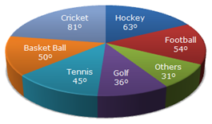

Question 1-2
The following pie chart shows the expenditure of a company on various sports.

Slide 4
Question 1
How much does the amount spent on Cricket exceeds on Hockey, if the total amount spent on sports during the year be Rs. 1,80,00,000?
A)
Rs. 9,00,000
B)
Rs. 8,40,000
C)
Rs. 5,000
D)
Rs. 25000
Notes:
Answer : A
Explanation : 360 degrees 180 lakhs
81 degrees - 63 degrees=18 degrees
360 degrees = 180 lakhs
18 degrees = x
x=18*180/360=9 lakhs

Slide 5
Question 2
If the total amount spent on sports during the year was Rs. 2 Crore, the amount spent on Golf and Football together was:
A)
Rs.1 Crore
B)
Rs. 7000000
C)
Rs. 2500000
D)
Rs.0.5 Crore
Notes:
Answer : D
Explanation : 360 degrees -2 crores
Golf and Football together =36+54=90 degrees
360 degrees = 2 crores
then 90 degrees = x
x = 0.5 crore

Slide 6
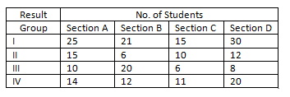
Question 3-5
The following table provides test results of two tests of the students of a class. Refer to the table to answer the questions.
Group I: Students failed in both tests
Group II: Students passed only in test 1
Group III: Students passed only in test 2
Group IV: Students passed in both tests

Slide 7
Question 3
How many students are there in the class?
A)
235
B)
178
C)
144
D)
None
Notes:
Answer : A
Explanation : No. of students in Sec-A =64No. of students in Sec-B =59
No. of students in Sec-C = 42
No. of students in Sec- D = 70
Total = 235

Slide 8
Question 4
In which of the sections did the minimum students pass?
A)
D
B)
C
C)
B
D)
A
Notes:
Answer : B
Explanation : Section A=15+10+14=39
Section B=6+20+12=38
Section C=10+6+11=27
Section D=12+8+20=40
Section C

Slide 9
Question 5
In which of the sections did the maximum students pass?
A)
D
B)
C
C)
B
D)
A
Notes:
Answer : A
Explanation : Section A=15+10+14=39
Section B=6+20+12=38
Section C=10+6+11=27
Section D=12+8+20=40
Section D

Slide 10
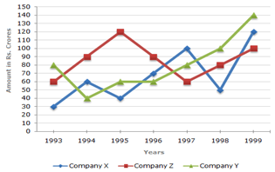
Question 6
The following chart gives the sales of 3 companies over years. Study the chart and answer the given question.
In which of the given pairs of years the total sales of the 3 companies together are equal?

Slide 11
Question 6
A)
1995, 1998
B)
1996, 1998
C)
1997, 1998
D)
1995, 1996
Notes:
Answer : D
Explanation : 1995 , 1998 = (40 + 60 +120 ) = 220, ( 50 + 80 +100 ) = 230
1996, 1998 = (60 + 70 + 90 ) = 220, ( 50 + 80 +100 ) = 230
1997, 1998 = ( 60 + 80 +100 ) = 240, ( 50 +80 + 100 ) = 230
1995, 1996 = ( 40 + 60 + 120 ) = 220, ( 60 + 70 + 90 )= 220
In 1995 , 1996 the sales of 3 companies together is equal

Slide 12
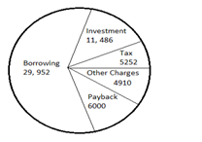
Question 7
The following pie chart shows the sources of funds collected by a company for its new project. Study the graph carefully and answer the question given below. By what percentage is the borrowed amount greater than that of the Payback amount?

Slide 13
Question 7
A)
314.42%
B)
225.6%
C)
336.76%
D)
399.2%
Notes:
Answer : D
Explanation : Borrowed amount = Rs. 29,952
Pay back amount = Rs. 6000
% increase = ( 29,952 - 6000 ) / 6000 * 100 = 399.2 %

Slide 14
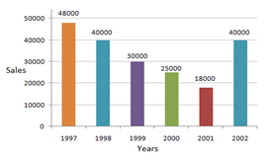
Question 8
The sales of the products of a sales company during 1997 to 2002 are shown in the following bar graph. Which are the two consecutive year between which the rate of change of sales is minimum?

Slide 15
Question 8
A)
1997 &1998
B)
1999 & 2000
C)
Both '1997 &1998' and '1999 & 2000'
D)
None
Notes:
Answer : C
Explanation : a) Rate of change of sales between 1997 & 1998 = ((48000-40000) / 48000)*100= 16.66
b) Rate of change of sales between 1999 & 2000 = ((30000-25000) / 30000)*100= 16.66

Slide 16
Question 9-11
Answer the questions on the basis of the information given below. A team of 5 players Arpit, Bimal, Chatur, Dinu and Elan participated in a ‘Freaket’ tournament and played four matches (1 to 4). The following table gives partial information about their individual scores and the total runs scored by the team in each match. Each column has two values missing. These are the runs scored by the two lowest scorers in that match. None of the two missing values is more than 10% of the total runs scored in that match.

Slide 17
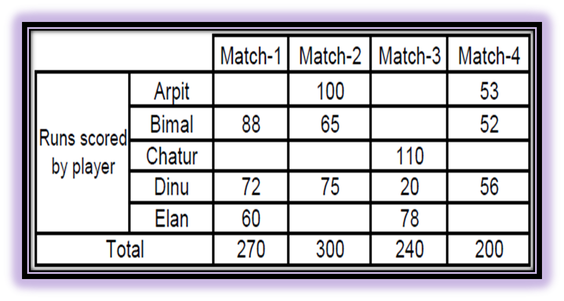
Question 9-11
Notes:
Let us analyse the scores of Match-1 first: Runs scored by Bimal, Dinu and Elan = 88 + 72 + 60 = 220 Hence, runs scored by Arpit and Chatur = 270 – 220 = 50 Also 10% of 270 = 27 So, both Arpit and Chatur can score a maximum of 27 runs but the sum of their scores should be 50. Arpit’s score’s range in Match-1 is 23–27 and subsequently Chatur’s score’s range in Match-1 is 27–23. Similarly Chatur and Dinu scored 30 runs each in Match-2. In Match-3 even though 10% of 240 = 24, as Dinu scored 20 runs, both Arpit and Bimal can score a maximum of 19 runs, but the sum of their scores should be 32. In Match-4, Chatur and Elan combined scored 200 – 53 – 52 –56 = 39 runs. As 10% of 200 = 20, one of Chatur or Elan scores 20 runs and the other scores 19 runs. The table can be re-written as:

Slide 18
Question 9-11
What is the maximum possible percentage contribution of Arpit in the total runs scored in the four matches?
A)
19.7%
B)
19.91%
C)
20.1%
D)
20%
Notes:
Option A Maximum possible runs scored by Arpit in Match-1 = 27 Maximum possible runs scored by Arpit in Match-3 = 19 Maximum possible percentage contribution: = (27+ 100+19+53)/(270+ 300+240+ 200) × 100% =199/1010 ×100 % = 19.7 %

Slide 19
Question 12
If the absolute difference between the total runs scored by Arpit and Chatur in the four matches is minimum possible then what is the absolute difference between total runs scored by Bimal and Elan in the four matches?
(a) 32
(b) 37
(c) 27
(d) Cannot be determined
Notes:
Option B Maximum possible total runs scored by Chatur in the four matches = 27 + 30 + 110 + 20 = 187. In such a case minimum possible total runs scored by Arpit in the four matches = 23 + 100 + 13 + 53 = 189. Difference = 189 – 187 = 2 (minimum possible) Subsequently total runs scored by Bimal in the four matches = 88 + 65 + 19 + 52 = 224. Also, total runs scored by Elan in the four matches = 60 + 30 + 78 + 19 = 187 Absolute difference = 224 – 187 = 37

Slide 20
Question 12
The players are ranked 1 to 5 on the basis of the total runs scored by them in the four matches, with the highest scorer getting Rank 1. If it is known that no two players scored the same number of total runs, how many players are there whose rank can be exactly determined?
(a) 0 (b) 1 (c) 3 (d) 5
Notes:
Option C Individual ranges for total score: Arpit -> 189 199 Bimal ->218 224 Chatur ->182 187 Dinu ->223 Elan ->187 188 Least total will be of Chatur (Rank 5) 2nd least will be Elan (Rank 4) Rank 3 must be of Arpit. It is not possible to determine the exact ranks of Bimal and Dinu.

Slide 21
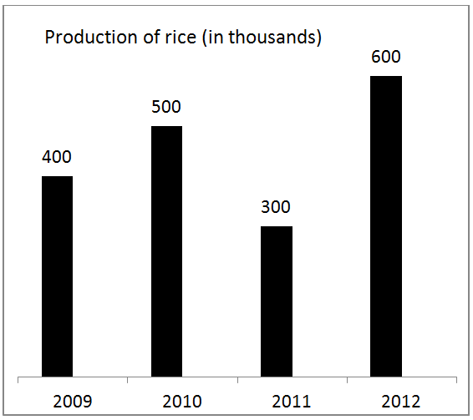
Question 13-15
Answer the questions based on the graph given below.

Slide 22
Question 13
From the above graph, what is the percentage increase in rice production in 2012 over 2010?
A)
40%
B)
20%
C)
15%
D)
13%
Notes:
Answer : B
Explanation : Rice production in 2010 is 50,000Rice production in 2012 is 60,000
The percentage increase is (60000-50000)/50000*100 = 20%

Slide 23
Question 14
Which of the given years has shown the maximum rice production?
A)
2010
B)
2011
C)
2012
D)
2009
Notes:
Answer : C
Explanation : As obvious from the graph the maximum production in rice is during the year 2012.

Slide 24
Question 15
What is the average of rice production in the given period?
A)
450
B)
500
C)
1800
D)
460
Notes:
Answer : A
Explanation : Average rice production is total amount of rice produced during the entire period divided by the number of years.Total production of rice = 1800
Average production of rice is 1800/4 = 450

Slide 25
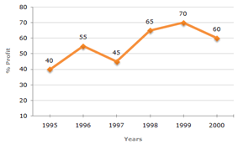
Question 16
The following graph shows the annual profit percent of a company. Study the graph and answer the question given below.
In which year is the expenditure maximum?
Notes:
We can’t determine max expenditure with profit.

Slide 26
Question 16
A)
2000
B)
1997
C)
1995
D)
Cannot be determined
Notes:
Answer : D
Explanation : This answer cannot be determined as they have asked for expenditure , but in the graph they have not mentioned anything about it. So it cannot be determined.

Slide 27
Question 16-20
The following tables show the batting performance of the Australian Cricket Team in a match. Table 1 indicates the score of the team at the fall of each wicket (from 1 to 10). Table 2 gives the runs scored by the 11 batsmen and the order in which they appeared in the batting line up.
Additional Information: • At any point there are two batsmen on the field, till the fall of the 10th wicket. Whenever the team loses a wicket, the new batsman comes as per the batting order. E.g. If one of the openers gets out, the no. 3 batsman takes the field.
• A partnership between any two batsmen is the number of runs scored while both of them are batting.

Slide 28
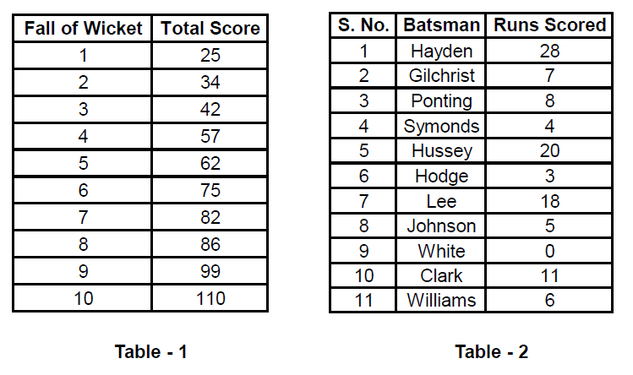
Question 16-20
Notes:
The first batsman to get out can be either Hayden or Gilchrist. Table 1 states that the first wicket falls at score 25. As Hayden himself scored 28 which is greater than 25, we can conclude that Gilchrist was the first to get out. At that time Hayden must have scored 25 – 7 = 18 runs. Similar analysis leads to the following table:

Slide 29
Question 16
How many batsmen lost their wicket between Hayden’s and Hussey’s dismissal?
A)
0
B)
1
C)
2
D)
More than 2
Notes:
For image view🡪 Notes Page
The first batsman to get out can be either Hayden or Gilchrist. Table 1 states that the first wicket falls at score 25. As Hayden himself scored 28 which is greater than 25, we can conclude that Gilchrist was the first to get out. At that time Hayden must have scored 25 – 7 = 18 runs. Similar analysis leads to the following table:
Option B Hodge lost his wicket between Hayden and Hussey.

Slide 30
Question 17
Who lost his wicket between Hayden’s and Hussey’s dismissal?
A)
Gilchrist
B)
Hodge
C)
Ponting
D)
Symonds
Notes:
Option B Hodge lost his wicket between Hayden and Hussey.

Slide 31
Question 18
How many runs were scored by the batsman who was the 9th to be dismissed?
A)
11
B)
18
C)
0
D)
Cannot be determined
Notes:
(2) Option D It can either be Clark or Lee. (See table).

Slide 32
Question 19
What was the percentage contribution to the second highest partnership of the batsman to be dismissed first in that partnership?
A)
33.33%
B)
61.53%
C)
71.43%
D)
None of these
Notes:
Option A The second highest partnership was for the fourth wicket between Hayden and Hussey for 15 runs. Percentage contribution of Hayden (who got dismissed first): 5/15×100=33.33%

Slide 33
Question 20
The Australian total comprised only ‘Singles’ and ‘Fours’. The number of Fours scored cannot exceed
A)
27
B)
24
C)
21
D)
20
Notes:
Option C Refer to the table. The maximum number of fours that could have been scored between the fall of any two wickets can be summarised as: 0 to 1st : 5 fours 1st – 2nd : 2 fours 2nd – 3rd : 2 fours 3rd – 4th : 3 fours 4th – 5th : 0 fours 5th – 6th : 3 fours 6th – 7th : 1 four 7th – 8th : 1 four 8th – 9th : 2 fours 9th – 10th : 2 fours So in all 21 fours could have been scored. The rest of the score is by virtue of singles.

Slide 34

THANK YOU

